Slide 1
Demystifying Scratchbuilding
A beginners guide
By Rich Mossholder
December 2020

Slide 2
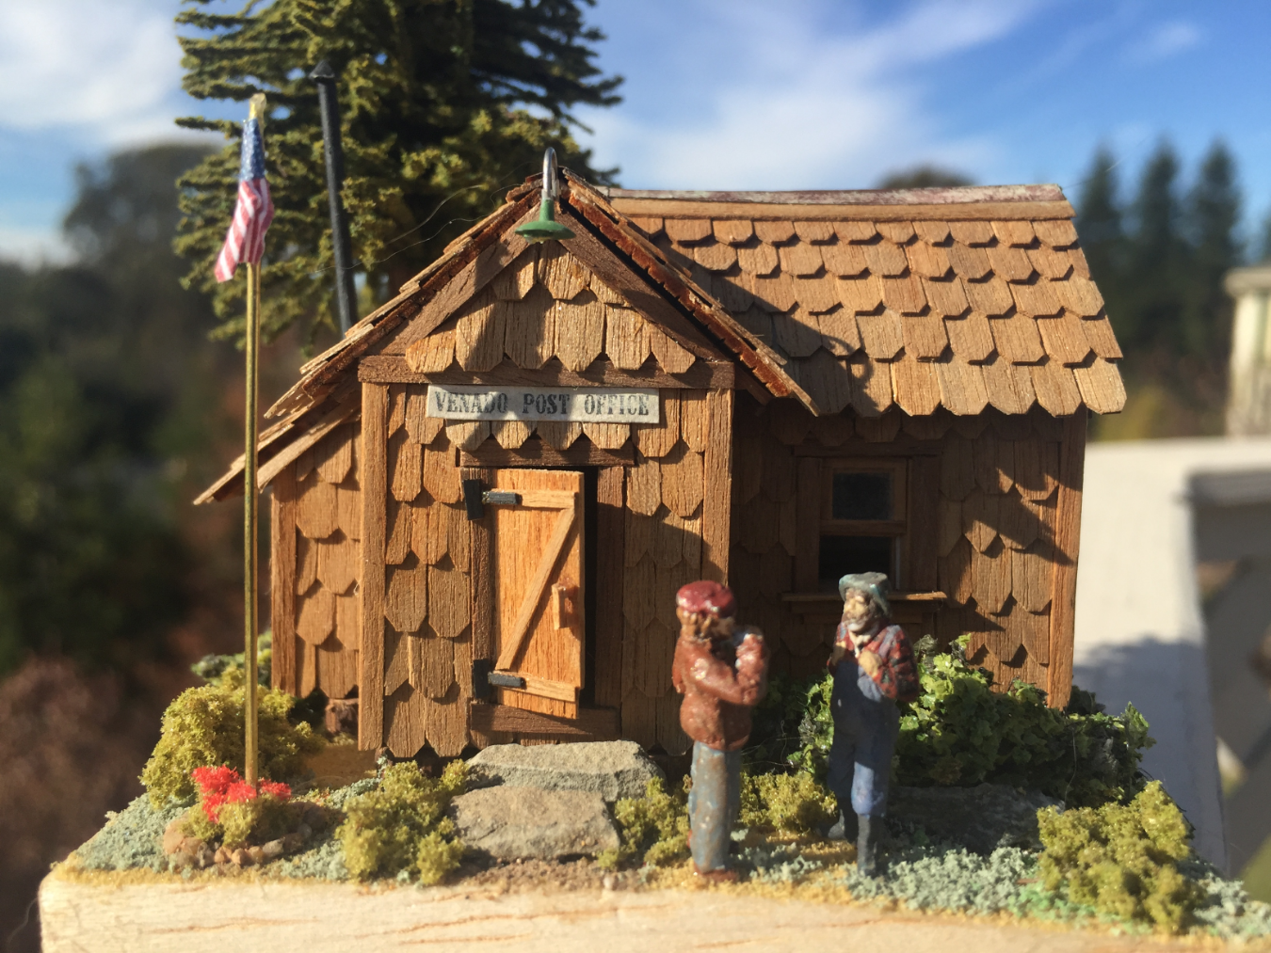
Why scratch building?
Subject of the model hasn't been manufactured.
Manufactured model sucks
Satisfaction of creating it yourself.
“You can't always get what you want, but if you try sometimes, you get what you need.” Rolling Stones

Slide 3
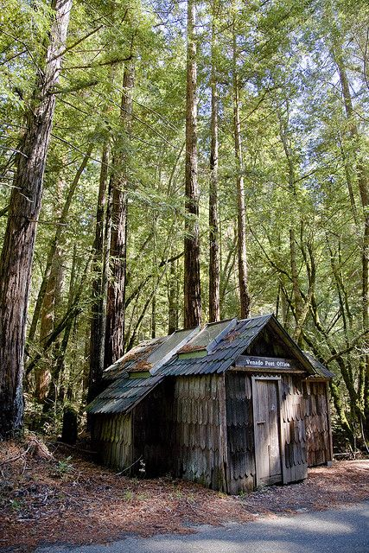
Where to begin?
Finding a suitable subject
Prototype or freelance
Working from drawings
Working from photos

Slide 4
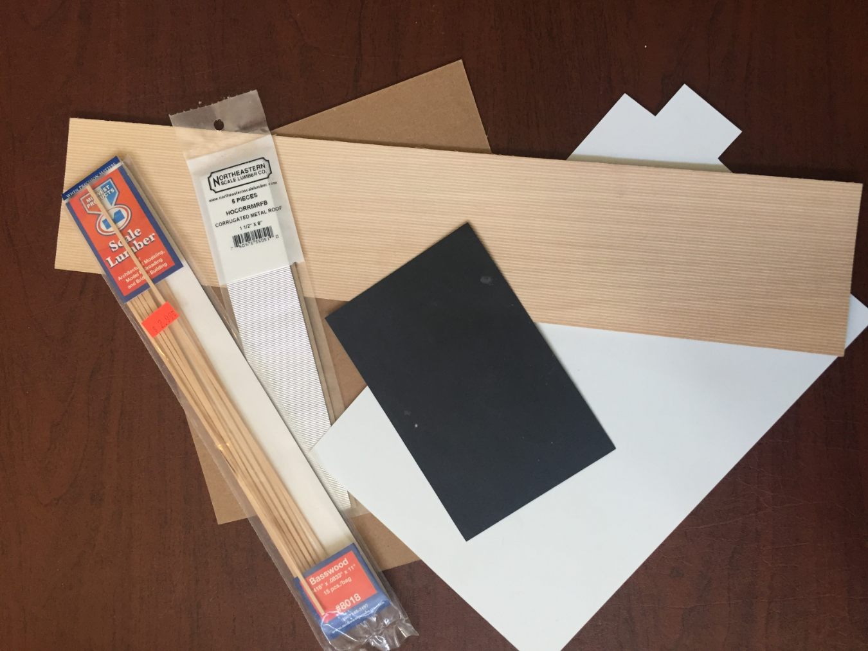
Materials
Wood
Cardstock
Styrene / Plastic
Metal
Paper
Plaster
Wire
Rubber
Resin
Foam
Stone

Slide 5
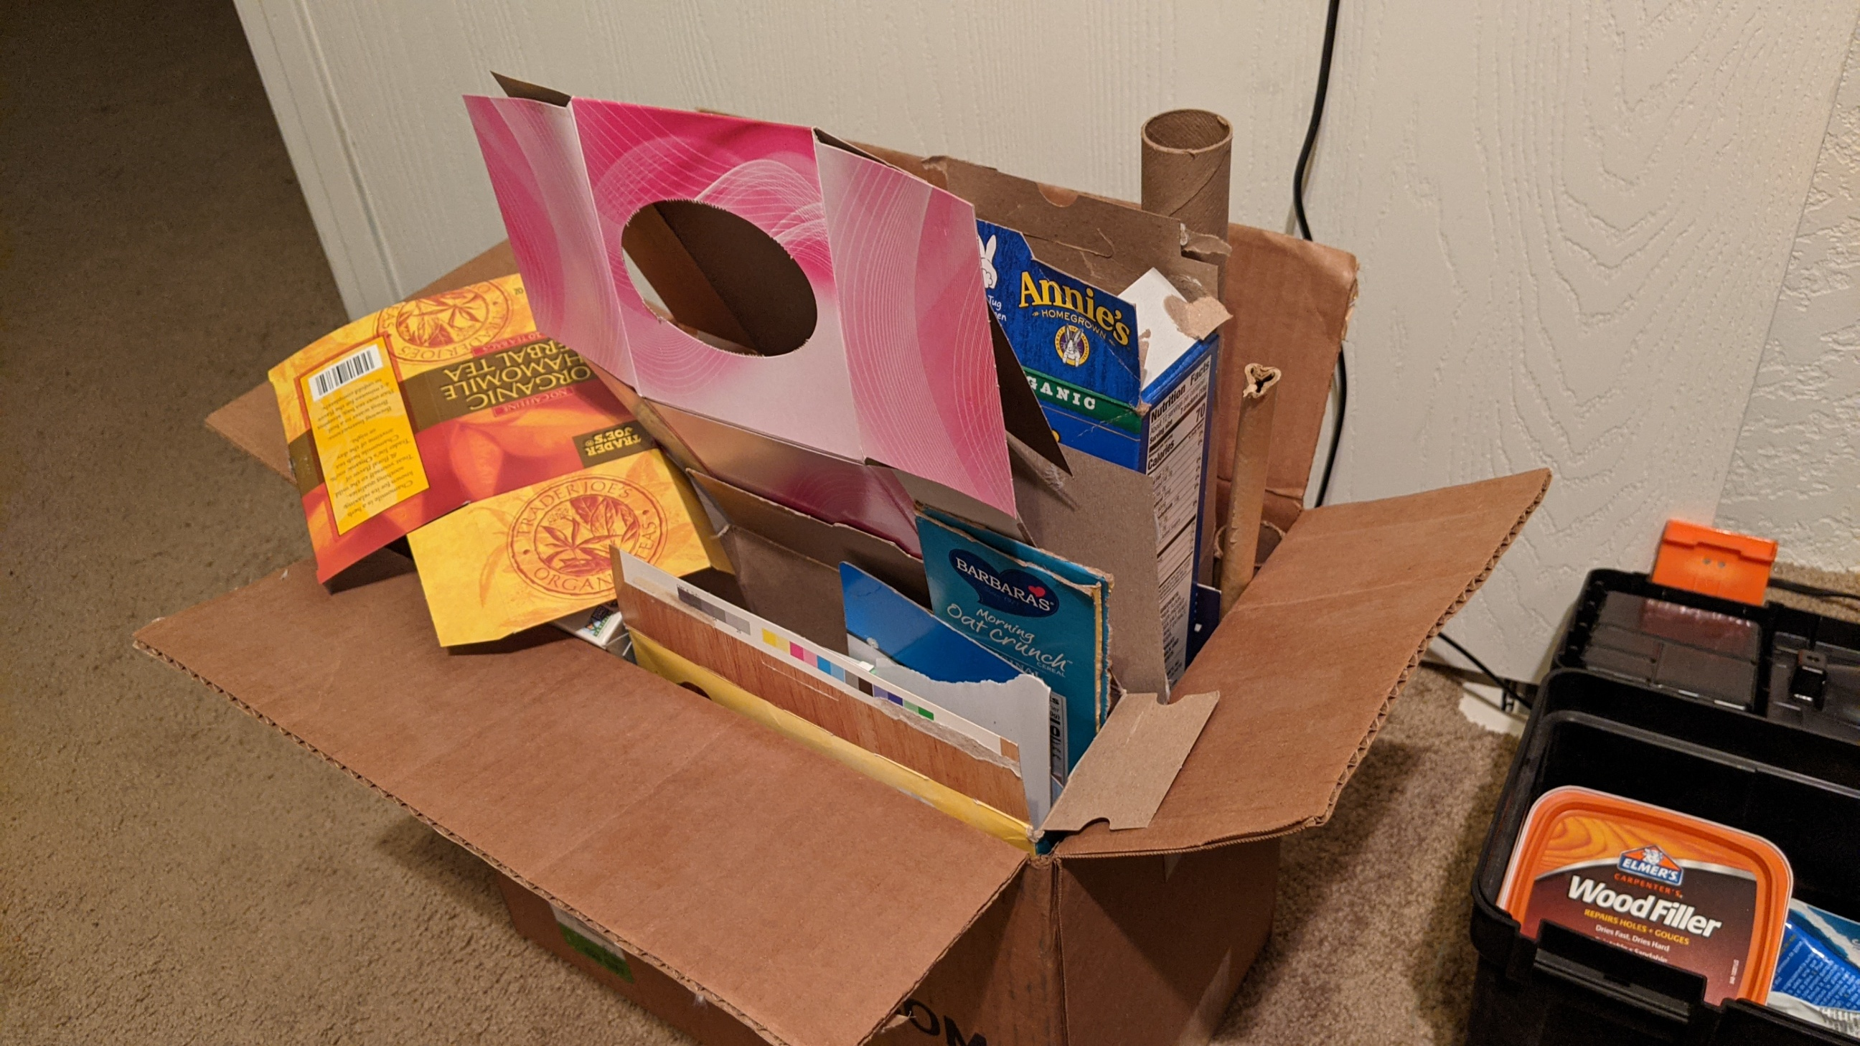
Materials can come from anywhere
Hobby shop
Hardware store
Toys
Packaging
Household items
Use objects that have the shape you need
Modify the parts to fit
Sanding
Cutting
Filing

Slide 6
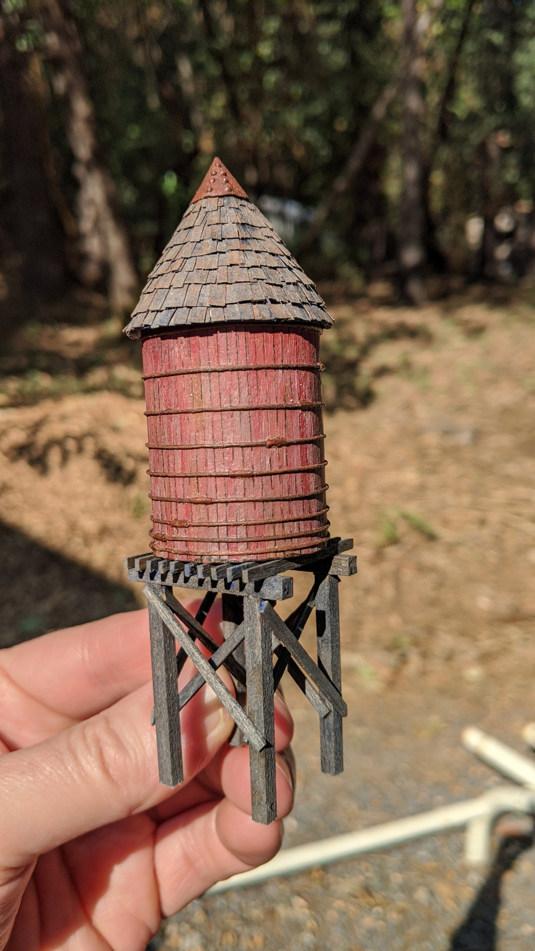
Cardboard tube
Scored cardstock for the plankes
Carpet thread for the hoops
Paper bits for turnbuckles
Timbers from a paint stir stick
Shingles from a paper bag
Aluminum foil for the roof cap
Model and photo by Peter Laughlin

Slide 7
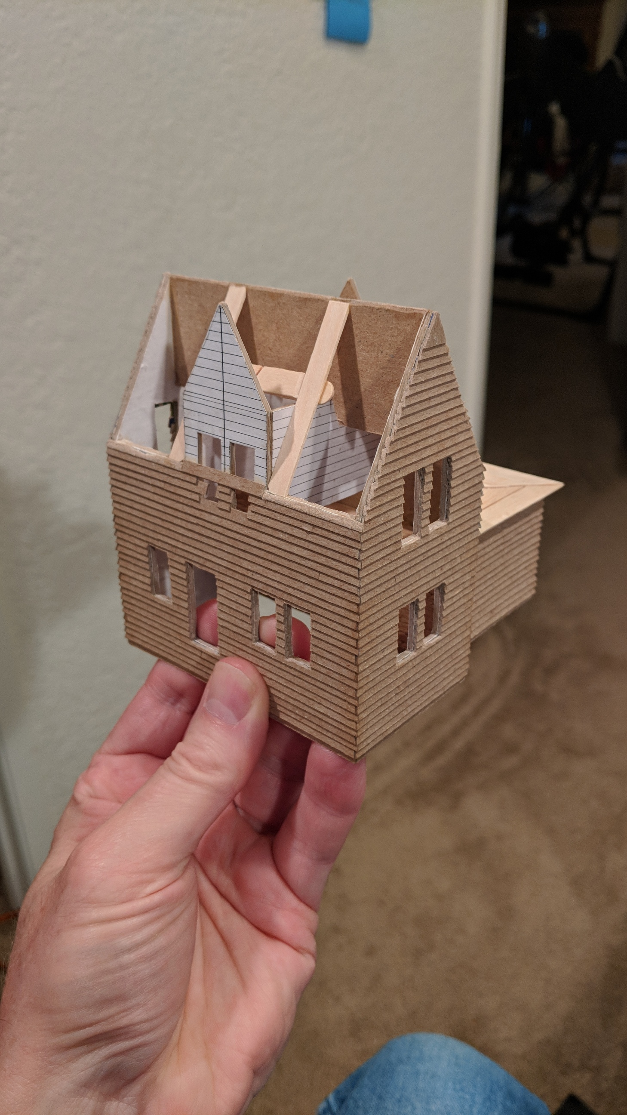
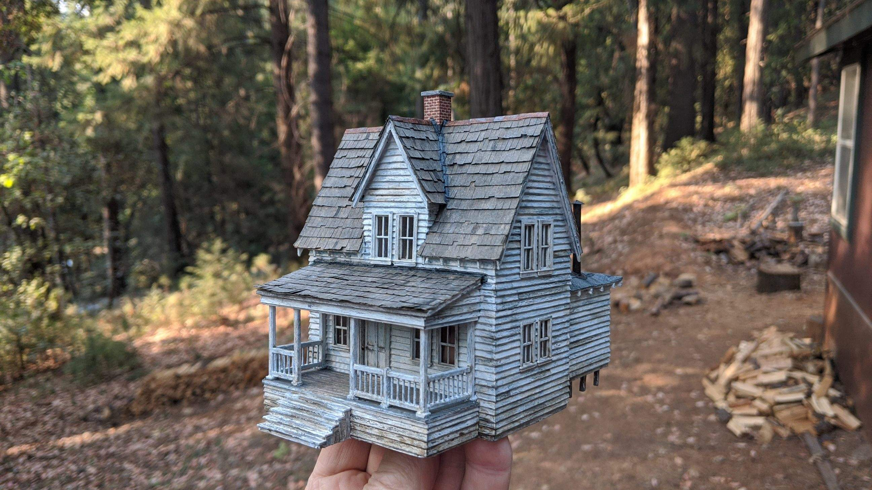
Before & After
Models and photos by Peter Laughlin
Card board
Popcicle sticks
Paint stir stick
Paper bag
Commercial doors and windows

Slide 8
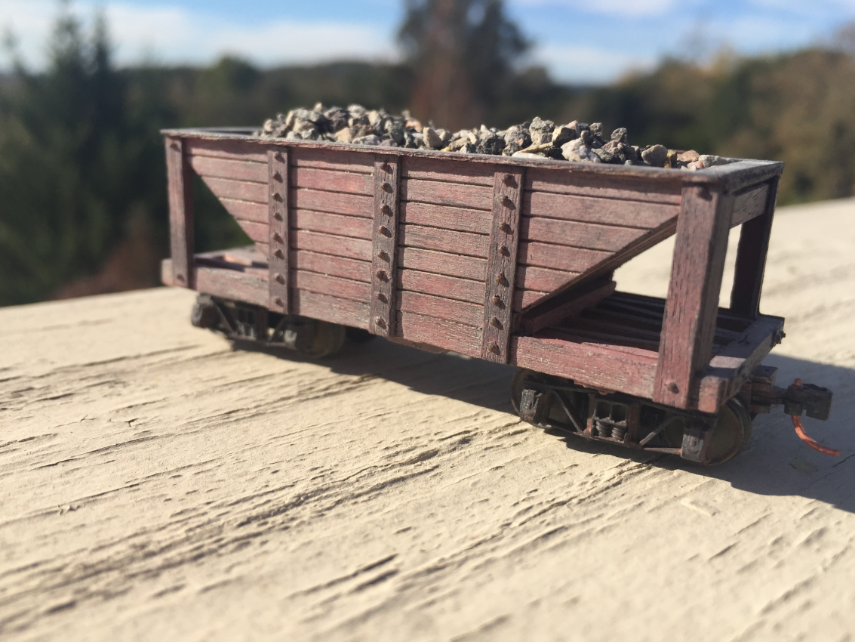
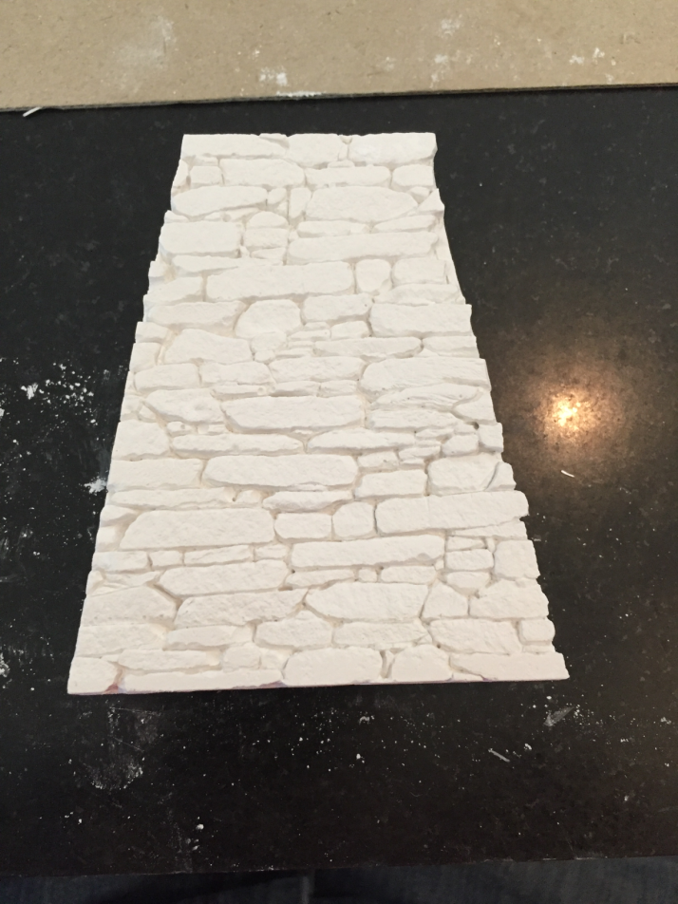

Slide 9
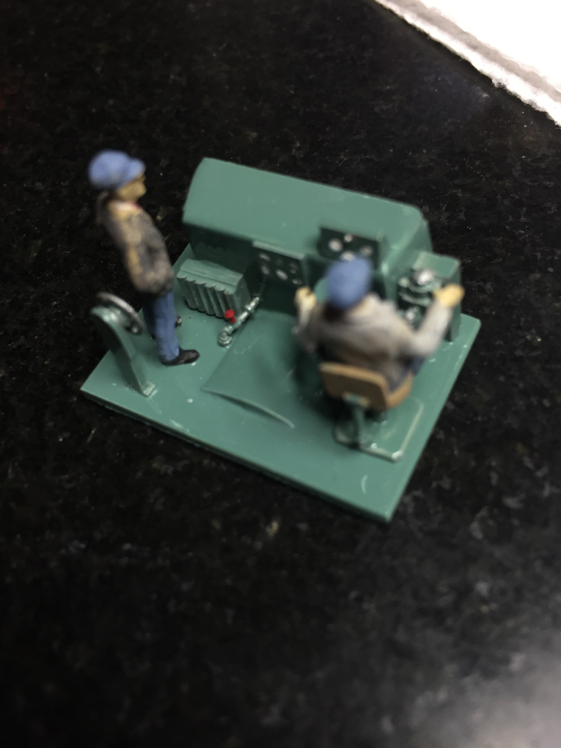
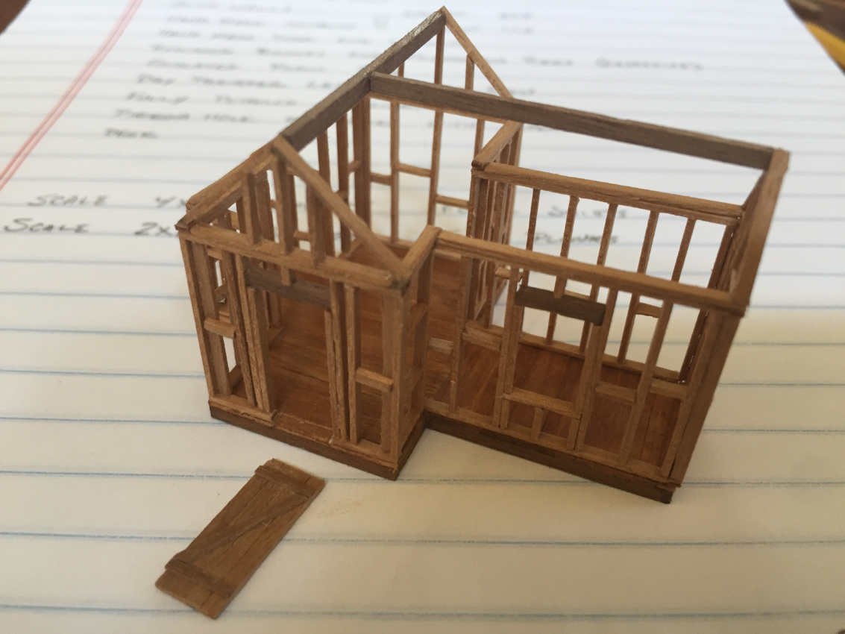

Slide 10
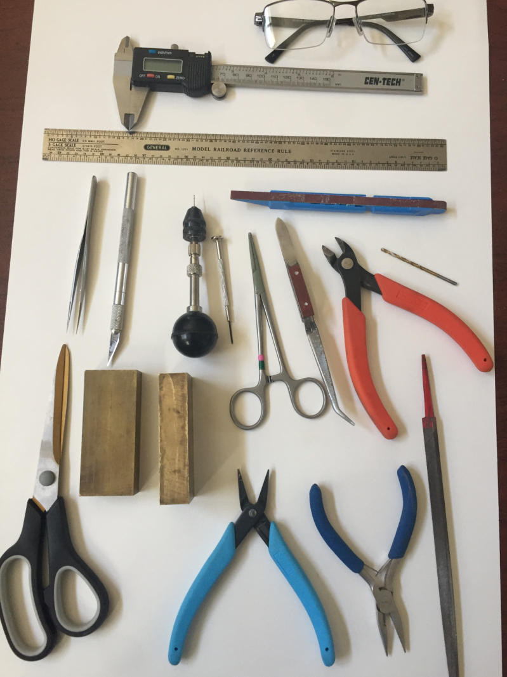
Tools
Think safety!
Basic tools.
Jigs.

Slide 11
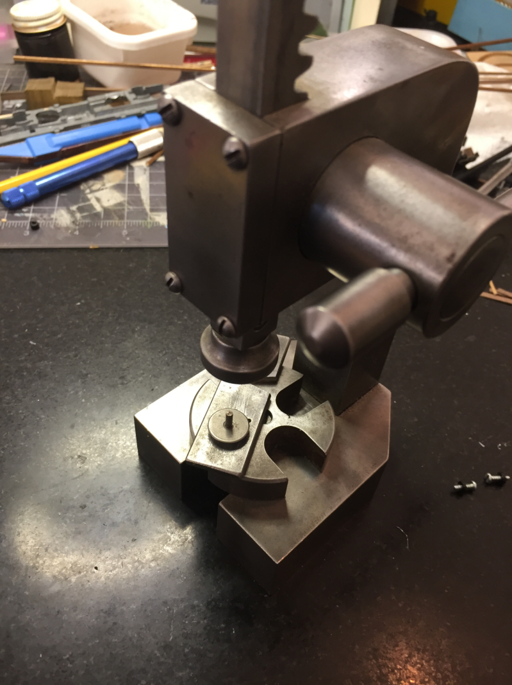
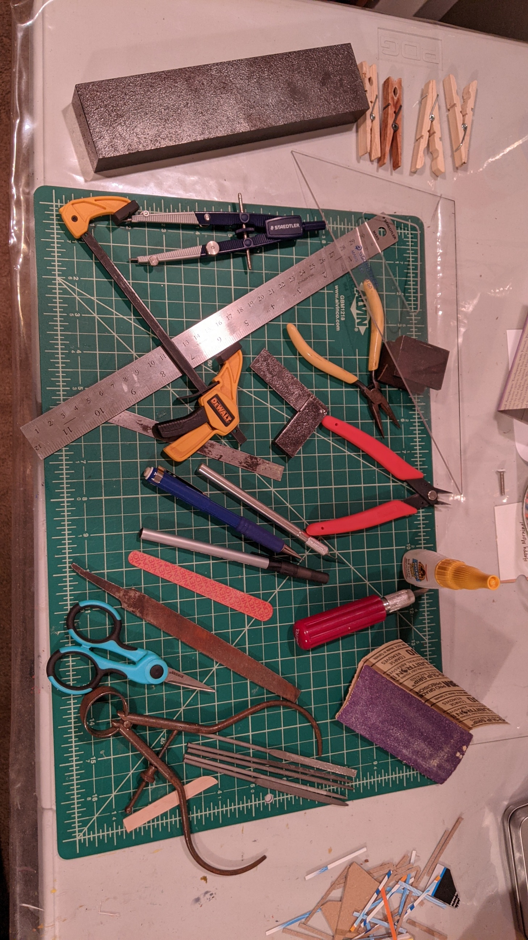

Slide 12
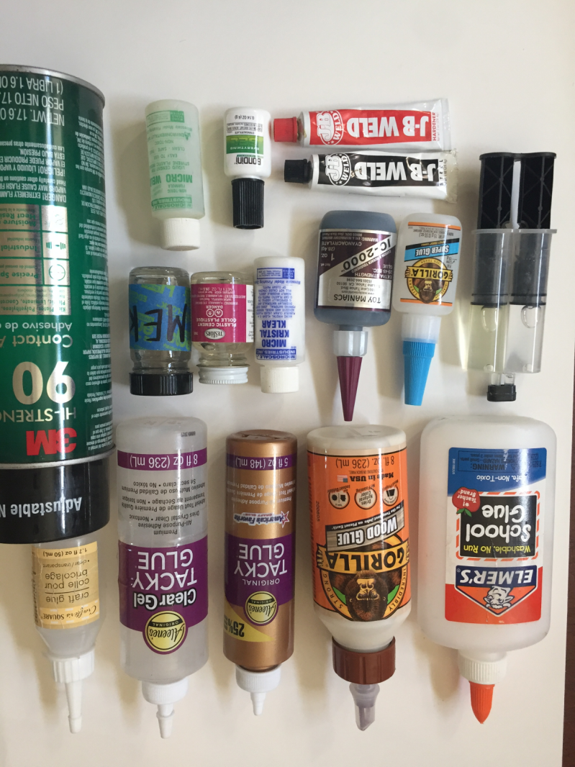
Adhesives
Types of adhesive.
Choosing the correct adhesive.
Applying adhesive correctly.

Slide 13
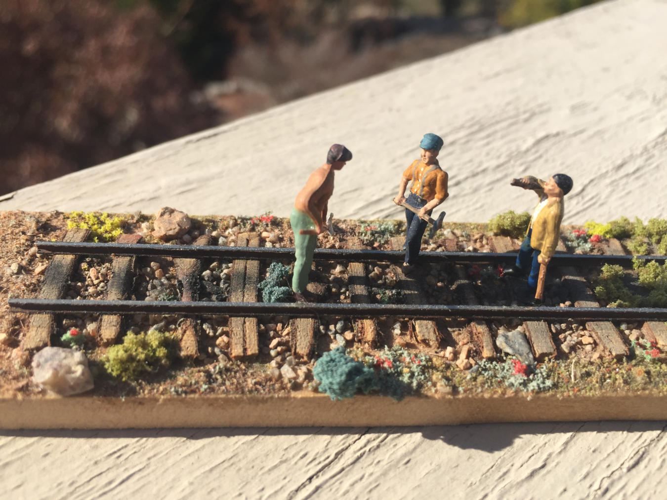
Construction Techniques
Patience isn't just a virtue!
Clean & organized work space.
Good lighting.
Sharp tools.
Secure the part you are working on.
Steady your hand.
Slow and deliberate movement.

Slide 14
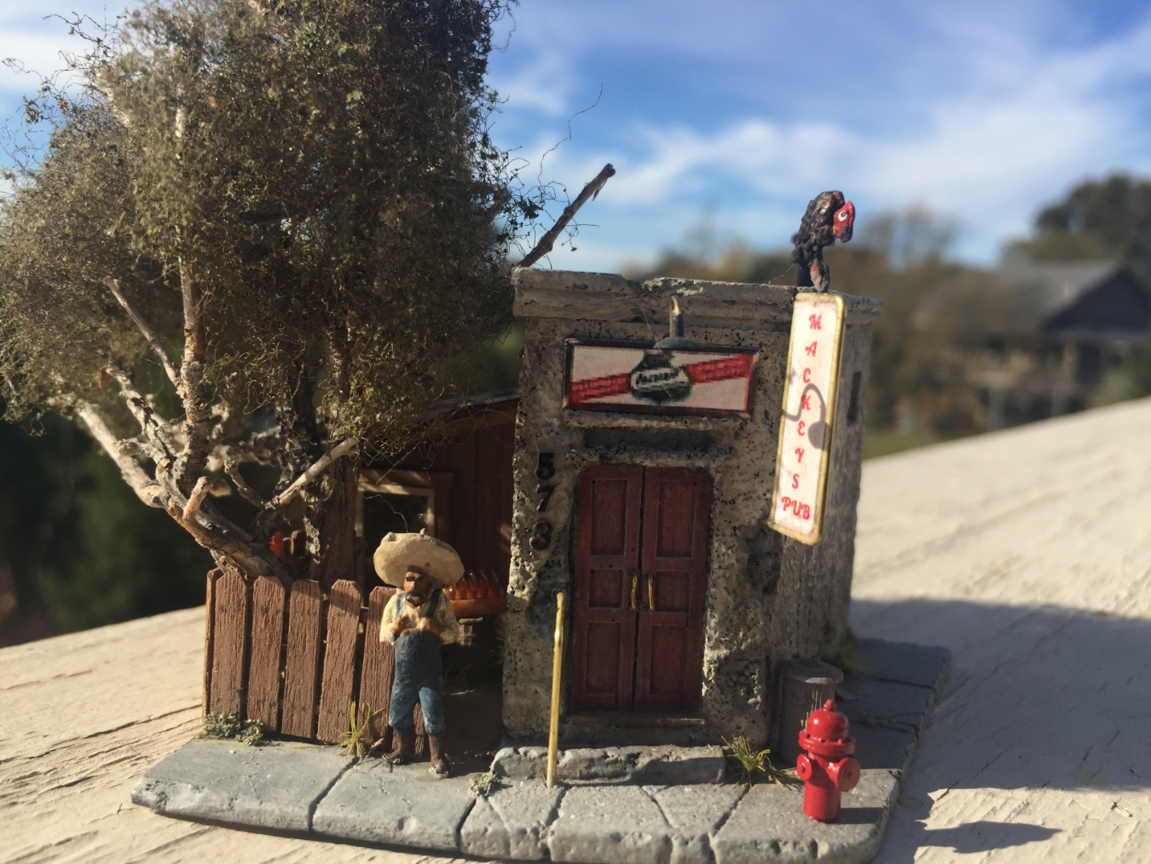
Details make your model come to life!
Details tell the story.
Study your surroundings for detail ideas.
Prototype photos show a lot of detail you might otherwise overlook.
Progress photos of your work help to identify things you might have missed, or messed up.

Slide 15
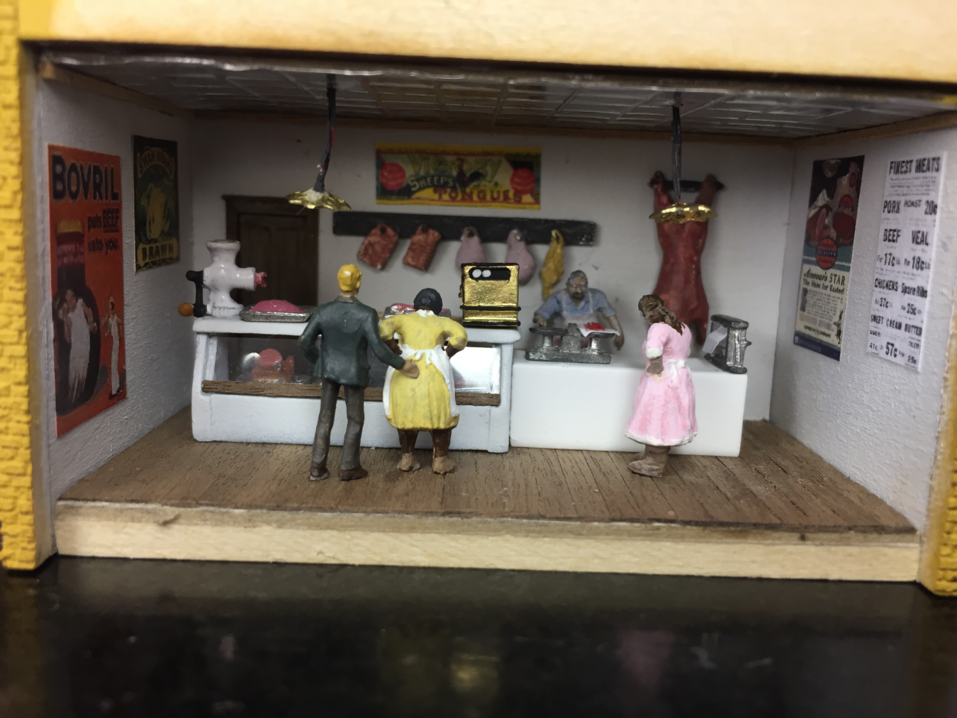

Slide 16
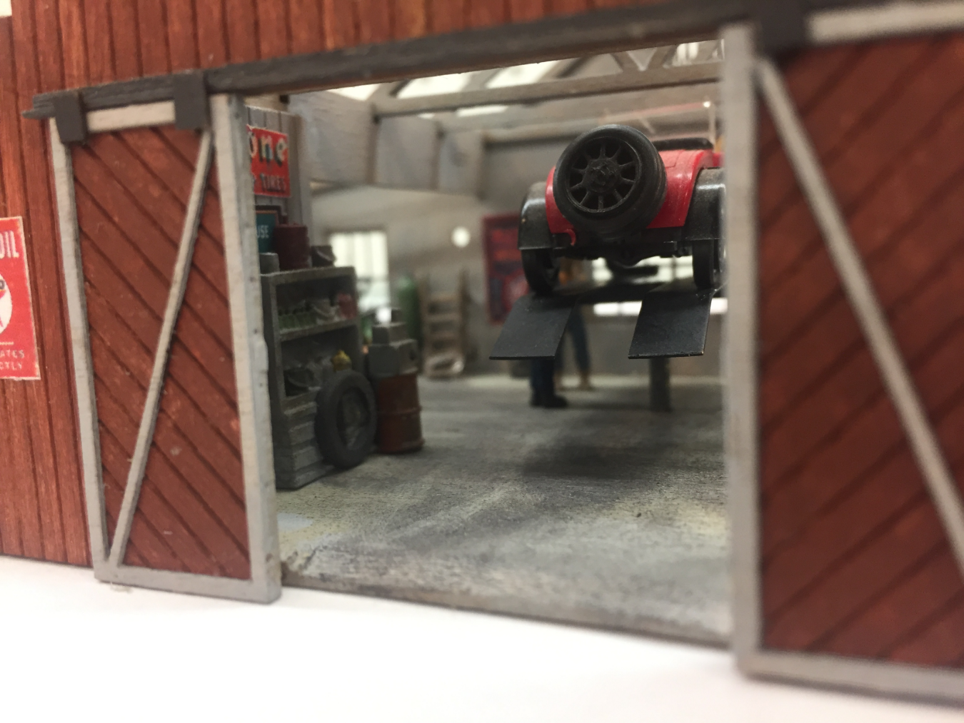
Thanks for stickin around!

Slide 17
Material resources
Specialty scale lumber (walnut stripwood)
www.modelexpo-online.com
Laser etched brick and stone sheet
www.larkspurlaserart.com
Basswood strip and sheet stock
www.northeasternscalelumber.com
Metal sheet and shapes
www.ksmetals.com
Doors and Windows
www.titchytraingroup.com

